Slide 1

JYOTHY INSTITUTE OF TECHNOLOGY
DEPARTMENT OF COMPUTER SCIENCE AND ENGINEERING
AIR QUALITY PREDICTION USING MACHINE LEARNING
Guide: Team Members:
Mr. Srinidhi Kulkarni Yashashwini R[1JT16CS061]
Mr. Saravana MK Pallavi Singh [1JT15CS034]

Slide 2
CONTENTS
Introduction
Problem Statement
Objectives
Hardware Requirement
Software Requirement
Technologies Used
Advantages And Future Scope
Existing and proposed system

Slide 3
INTRODUCTION
What is Machine Learning?
Machine learning is the study of computer algorithms that improve automatically through experience.
What is Air quality prediction?

Slide 4
PROBLEM STATEMENT
What is air pollution and what are the major pollutants.
Monitoring air quality.
Threat to life.

Slide 5
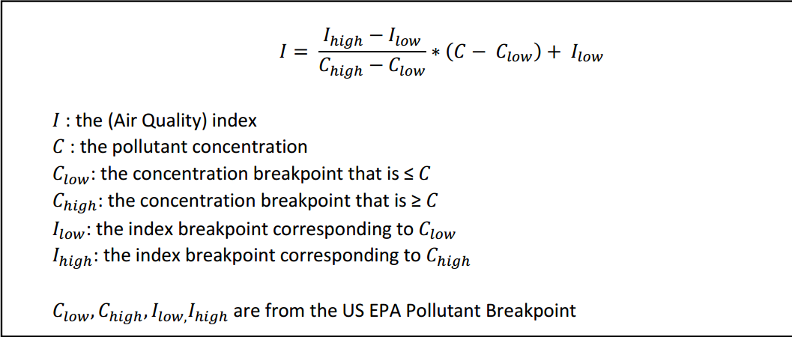
OBJECTIVES
What is AQI?
AQI is an indexing measure that defines the pollutant amount in air.
How is AQI calculated ?

Slide 6
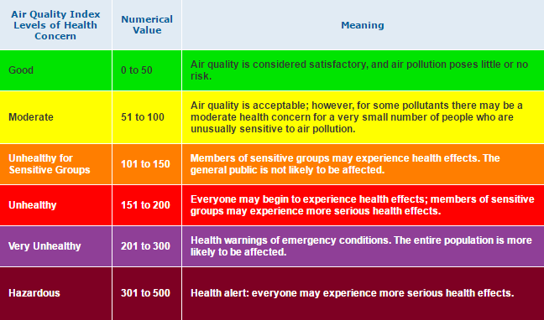
OBJECTIVE

Slide 7
HARDWARE REQUIREMENTS
Processor: Pentium IV/III
Hard disk: minimum 80GB
RAM: minimum 2GB

Slide 8
SOFTWARE REQUIREMENTS
Operating System: Windows
Application: Anaconda
Tool: Juypter Notebook/Spyder
Python version: 3.8
Framework: flask
Supporting tools: notepad++
Libraries: numpy, pandas, joblib, matplotlib, seaborn, plotly

Slide 9
TECHNOLOGIES USED
Machine Learning.
Data Science.
Web Technologies.

Slide 10
ADVANTAGES AND FUTURE SCOPE
Predicted result in web or desktop application.
Real time approach.
AI environment.

Slide 11
EXISTING AND PROPOSED SYSTEM
The current existing system is IOT based Air quality and pollution monitoring.
The proposed system is a machine learning approach to predict the air quality and showcase the time line of each place in advance by predicting the future outcomes.

Slide 12
THANK YOU

